Slide 1


Optimization In Solar Power
Generation

Slide 2
content
Business Problem
Data Dictionary
Project Architecture - Data Flow Diagram
Project Overview and Scope
Exploratory Data Analysis
Data Preprocessing
Data Visualization
Solution

Slide 3

Business Problem
The company struggles with Frequent fluctuations in energy output caused by variable environmental conditions and system inefficiencies are limiting optimal solar power generation
Business Constraint: Minimize operational cost.
Business Objective: Maximize Power Production and Performance
Business Success Criteria: Achieve a 20-30% increase in profit.
Economic Success Criteria: Increase 30% In revenue, and reduce operational costs through Improved solar power generation efficiency

Slide 4
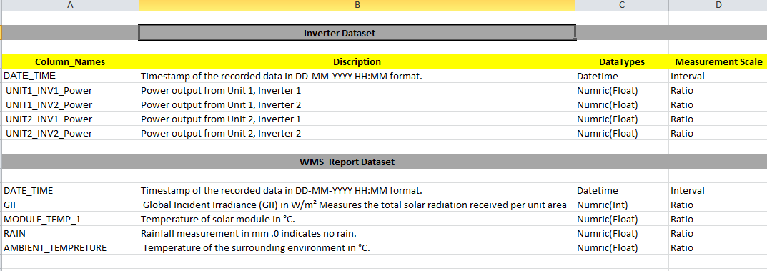
Data Dictionary

Slide 5
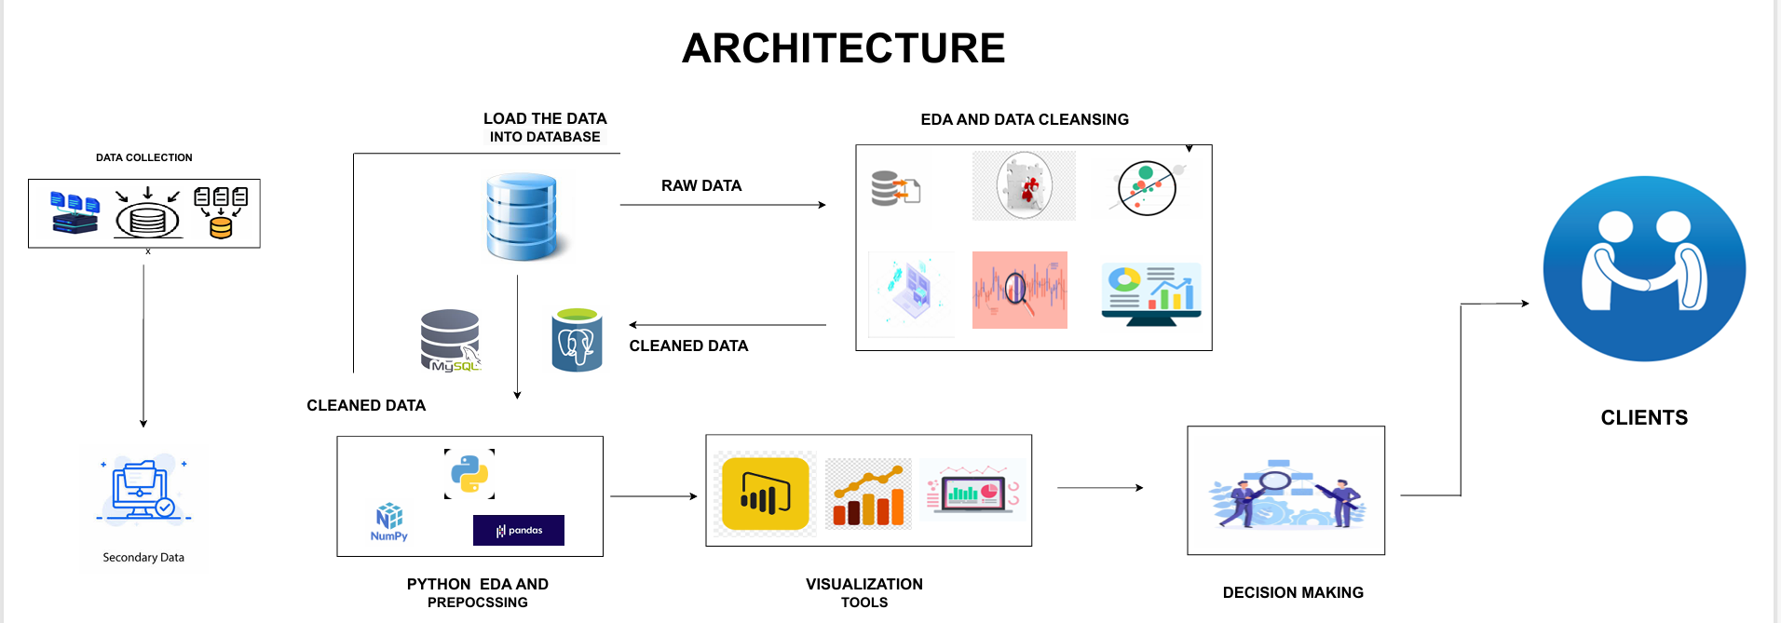

Slide 6
Project Overview and Scope Implement A Digital Solution To Automate Data Collection, Analysis, And Visualization, Enabling Real-time Monitoring And Optimization Of Solar Power Generation Efficiency. This Will Help In Reducing Operational Costs And Maximizing Energy Production. Scope:- 1.Automate Data Collection From Inverters And Weather Monitoring Systems (WMS). 2.Implement Real-time Data Analytics And Visualization For Energy Performance Tracking. 3.Develop Predictive Models To Optimize Power Generation And Detect Inefficiencies. 4.Integrate With Existing Solar Panel Systems And Inverters For Seamless Operation. 5.Train Operations And Maintenance Teams On Data-driven Decision-making And System Optimization.

Slide 7
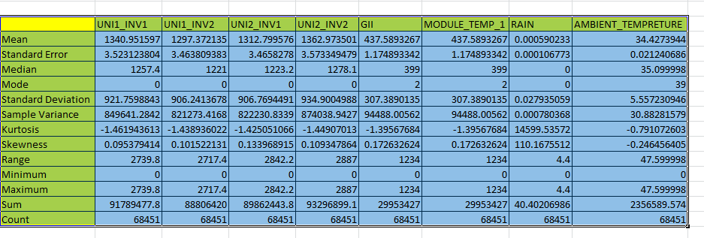
exploratory Data Analysis [EDA]

Slide 8
Data Preprocessing
Finding Dublicate values
By using function dublicated() we can find the dublicate values on the dataset
Finding and Handling Missing/Null Values
By using function isnull() we cand find the missing and null values and its handled by imputation method
Detecting outliers
By using Visualization of Boxplot we can detect Is there are outlier present or not
Removing Outliers
By using Replace method we can replace outliers with upper limit and lower limit
Notes:
Keep observations

Slide 9
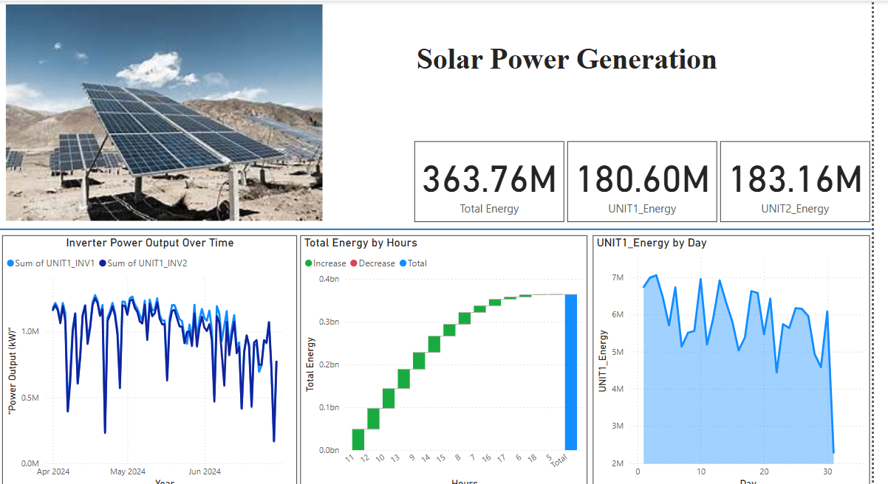
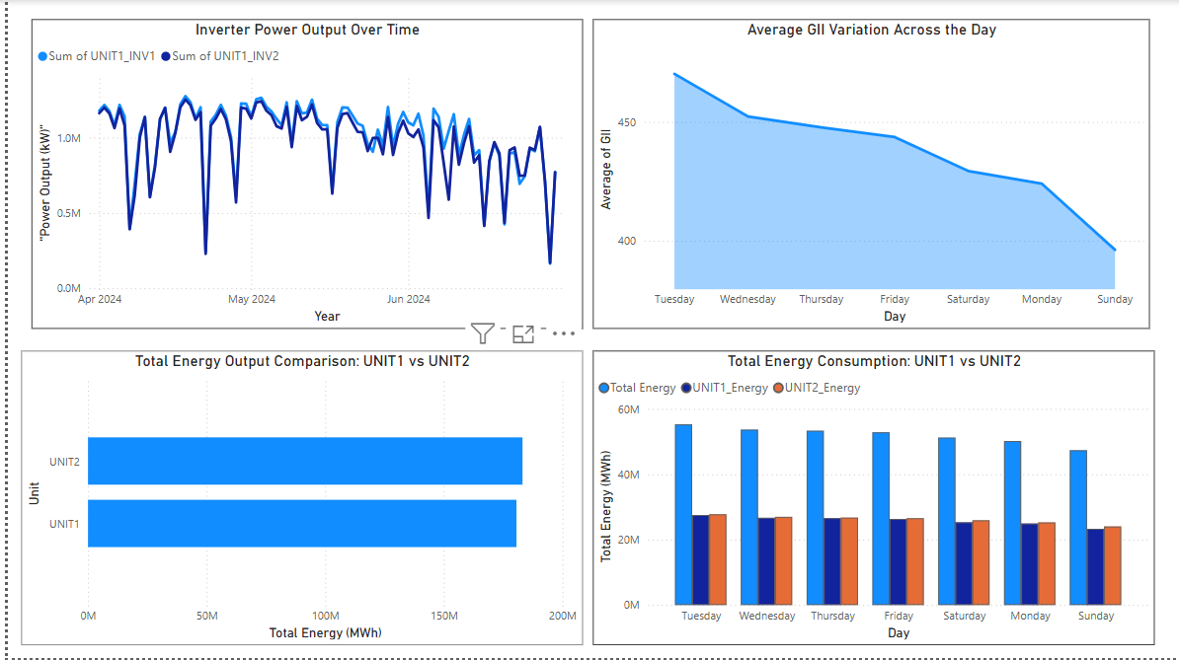
Data Visualization

Slide 10
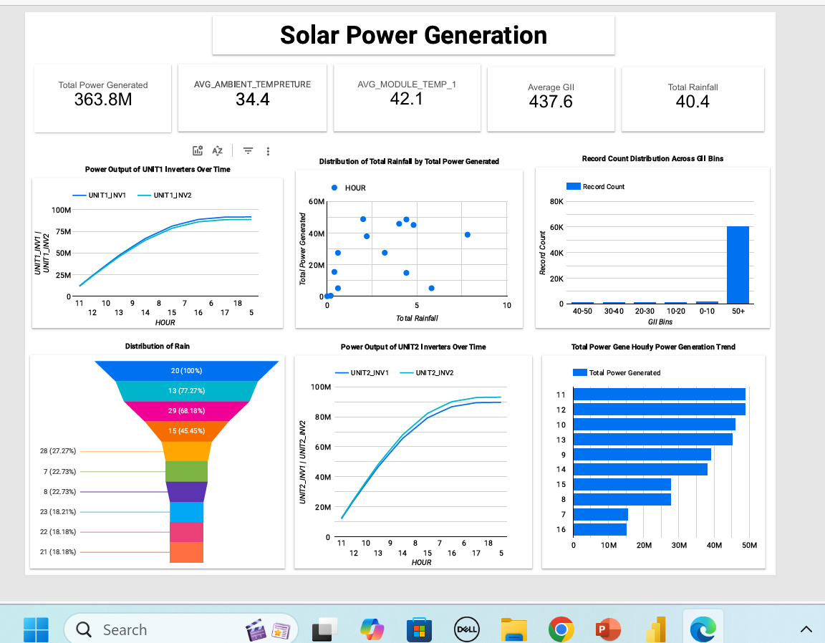
Data Visualization

Slide 11

solution
Automate Data Collection From Inverters And WMS
Implement Real-time Data Analytics And Visualization
Develop Predictive Models For Performance Optimization
Integrate With Existing Solar Panel Systems And Inverters
Train Operators /Maintenance Teams On Optimization Strategies
Reduce Energy Loss And Improve System Efficiency
Implement Dynamic Monitoring And Preventive Maintenance

Slide 12


